Slide 1
Project Planning Phase
Project Planning Template (Product Backlog, Sprint Planning, Stories, Story points)
Date | 22 October 2022
Team ID | PNT2022TMID45157
Project Name | Project - A Novel Method for Handwritten Digit Recognition System
Maximum Marks | 8 Marks
Product Backlog, Sprint Schedule, and Estimation (4 Marks)
Sprint | Functional Requirement (Epic) | User Story Number | User Story / Task | Story Points | Priority | Team Members
Sprint-1 | Home | USN-1 | As a user, I can upload the image that needs to be recognized. | 2 | High | Hariharan A T, Karthikeyan S, Gowrav Krishna V, Kousic A
Sprint-2 |  | USN-2 | As a user, I can use the application feature to recognize the uploaded image. | 2 | High | Hariharan A T, Karthikeyan S, Gowrav Krishna V, Kousic A
Sprint-3 |  | USN-3 | As a user, I can download the processed input image. | 2 | Low | Hariharan A T, Karthikeyan S, Gowrav Krishna V, Kousic A
Project Tracker, Velocity & Burndown Chart: (4 Marks)
Sprint | Total Story Points | Duration | Sprint Start Date | Sprint End Date (Planned) | Story Points Completed (as on Planned End Date) | Sprint Release Date (Actual)
Sprint-1 | 20 | 6 Days | 24 Oct 2022 | 29 Oct 2022 | 20 | 30 Oct 2022
Sprint-2 | 20 | 6 Days | 31 Oct 2022 | 05 Nov 2022 | 20 | 06 Nov 2022
Sprint-3 | 20 | 6 Days | 07 Nov 2022 | 12 Nov 2022 | 20 | 13 Nov 2022

Slide 2
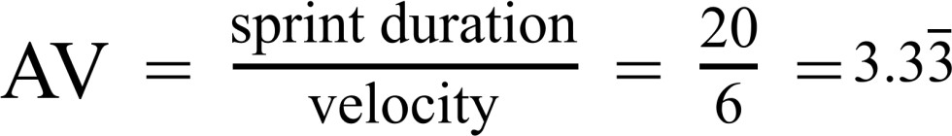
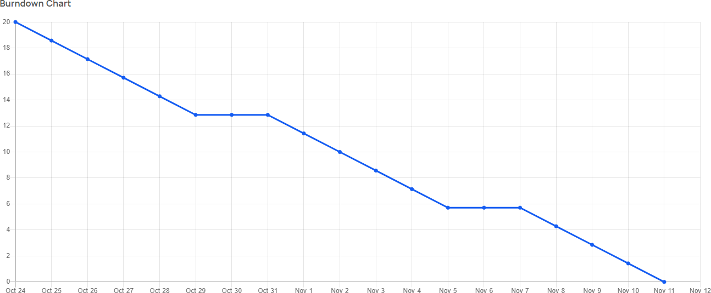
Velocity:
Burndown Chart:

